Slide 1

Data Science Midterm Project
JAFARNEJAD, DIBA & WHITE, KORINNE ANGELA

Slide 2
Project/Goals
1. Load, preprocess, and explore housing sales data.
2. Train, evaluate, and optimize supervised learning models.
3. Fine-tune the best model and implement a prediction pipeline.

Slide 3
Process
I. Data Cleaning, Exploration and Visualization
II. Model Selection
III. Finetuning
IV. Model Evaluation & Results

Slide 4
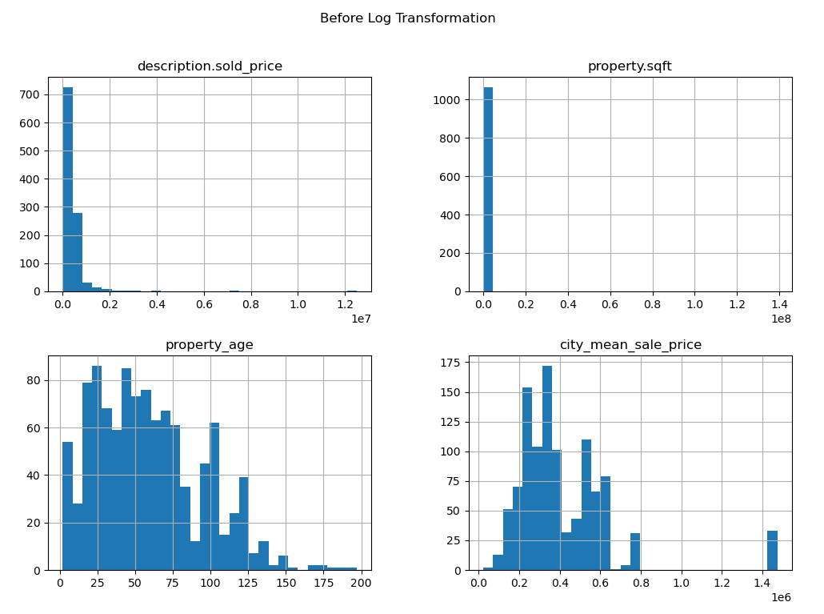
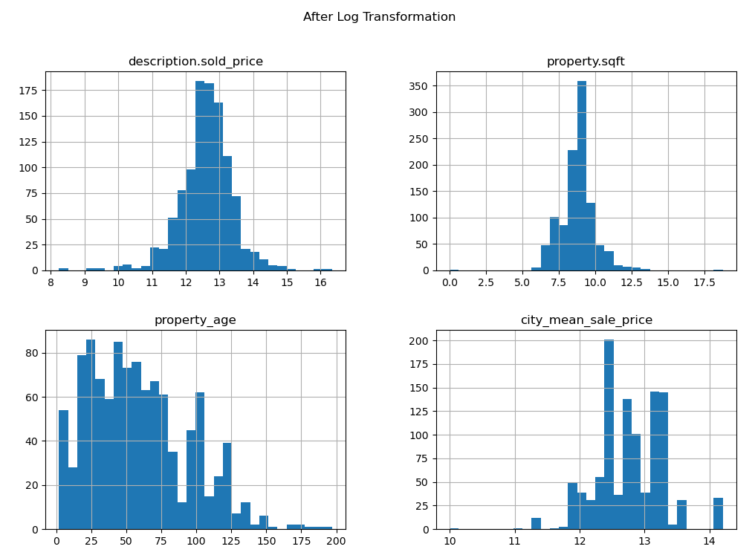

I. Data Cleaning, Exploration and Visualization

Slide 5
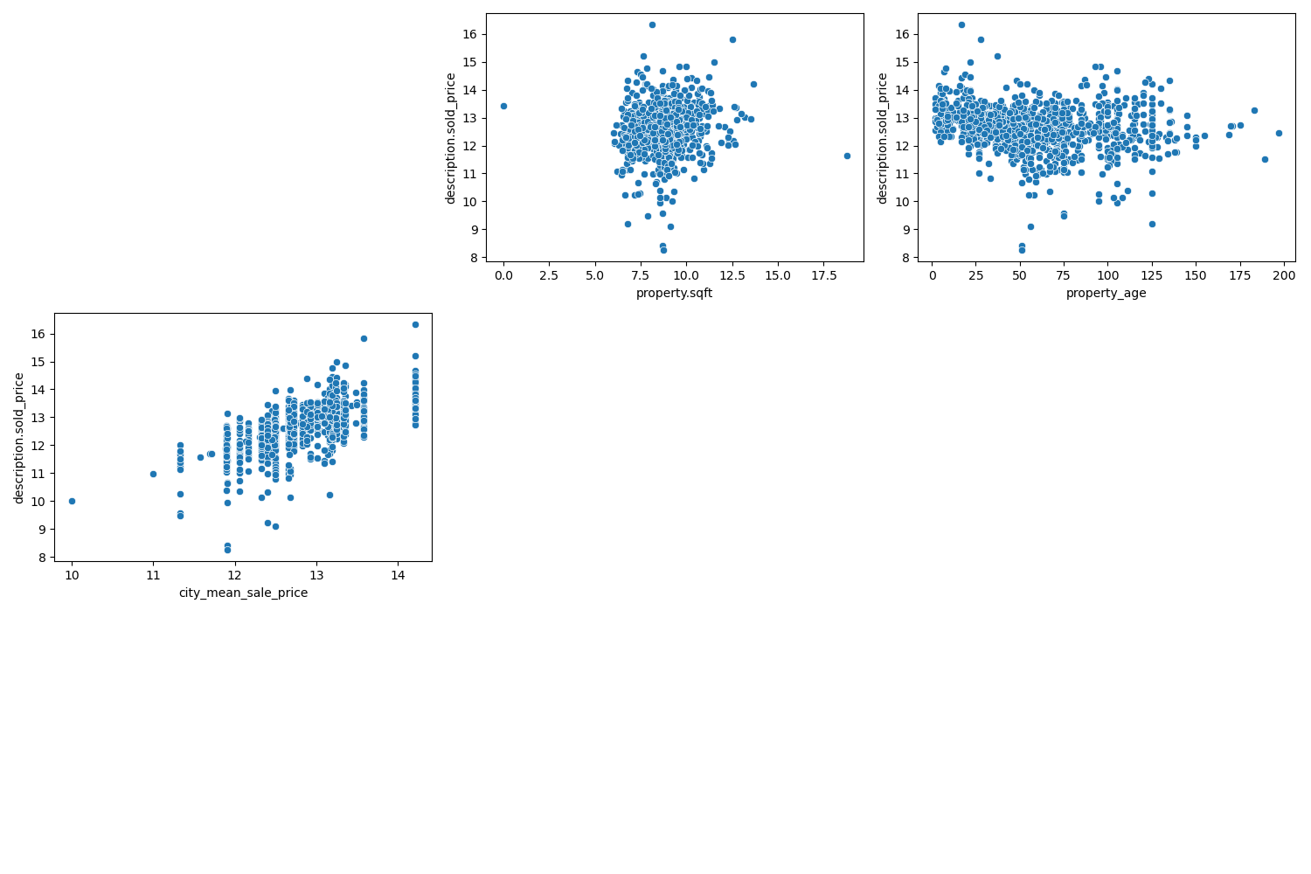
I. Data Cleaning, Exploration and Visualization

Slide 6
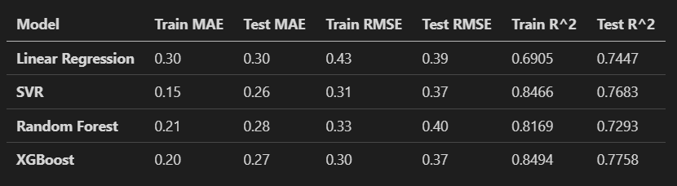
II. Model Selection: XGBoost

Slide 7
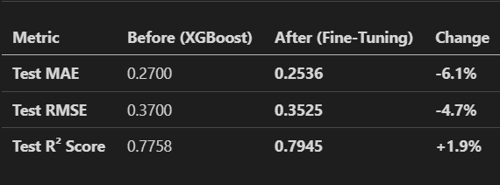
III. Fine-Tuned XGBoost’s Performance:

Slide 8
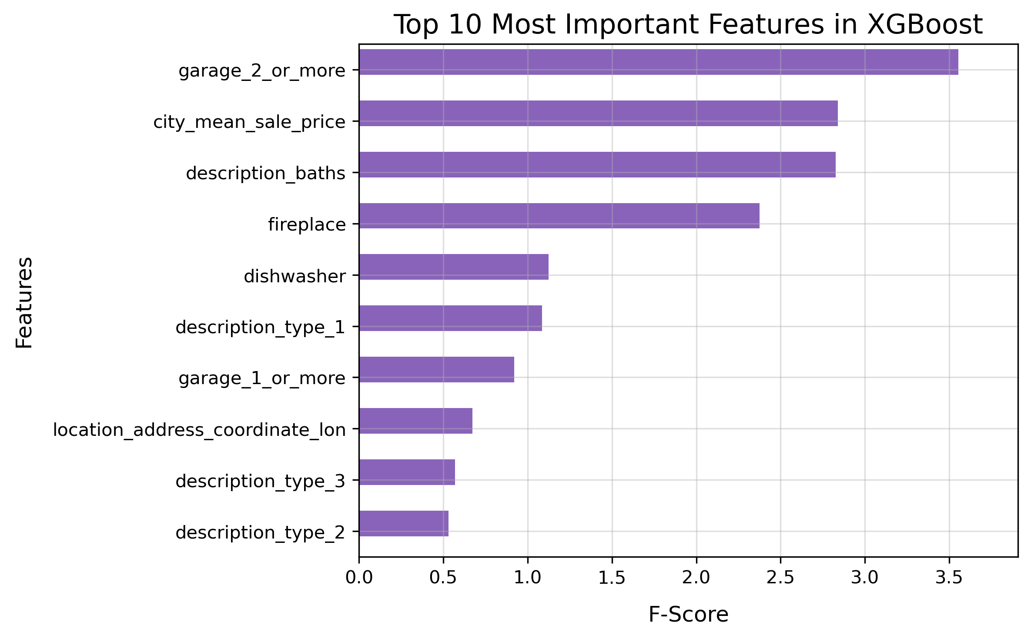
IV. Model Evaluation & Results

Slide 9
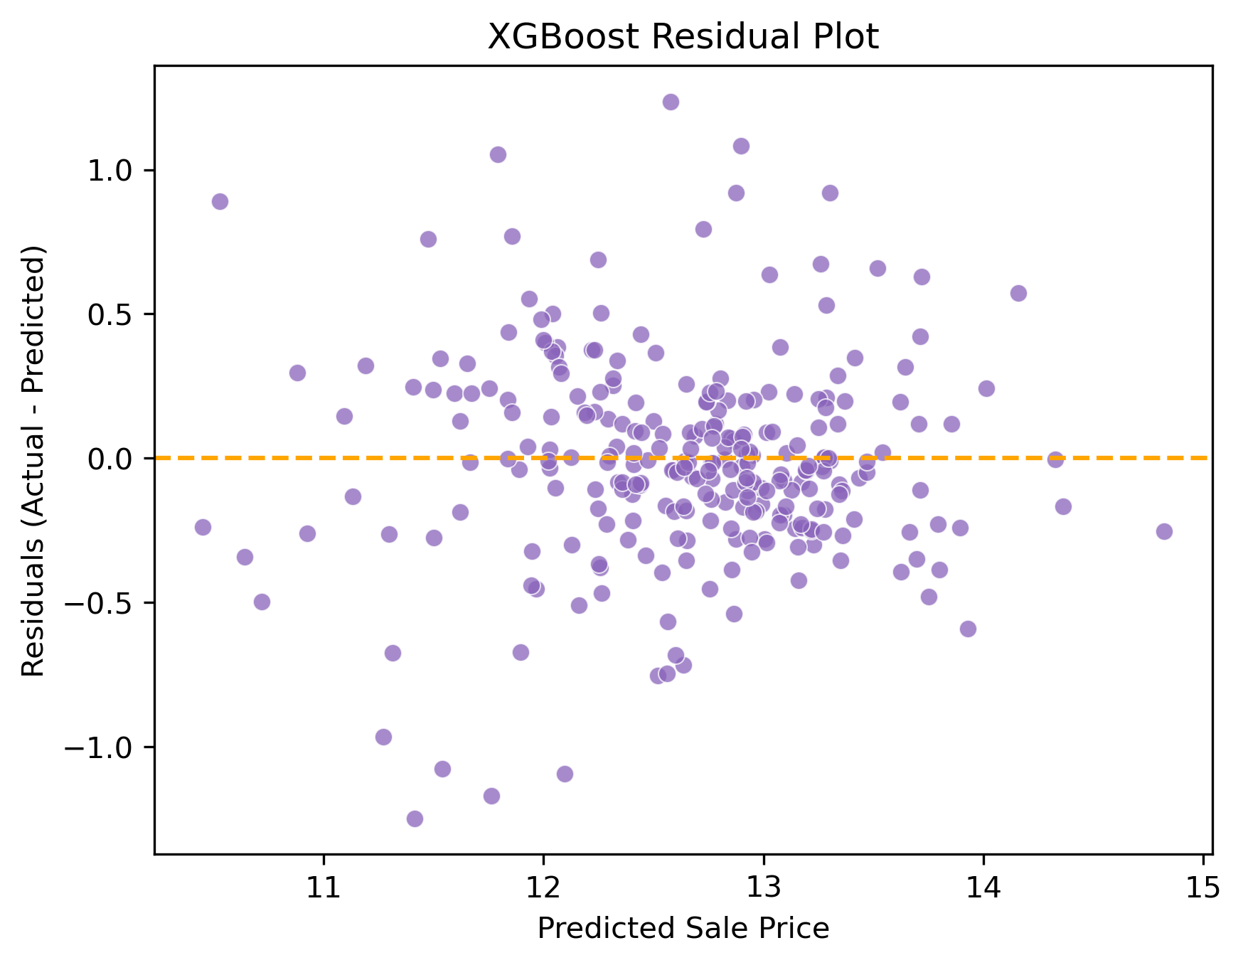
IV. Model Evaluation & Results

Slide 10
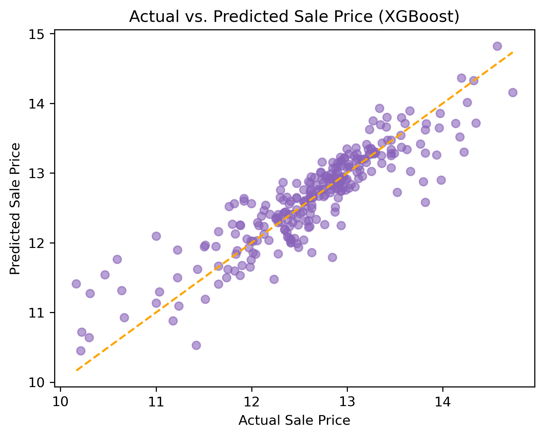
IV. Model Evaluation & Results

Slide 11
Conclusion
Our project successfully explored housing sales data, implementing data cleaning, visualization, and machine learning techniques to build a predictive model.
After evaluating multiple models, XGBoost was chosen for its strong performance.
Through fine-tuning, we optimized its predictive accuracy, demonstrating its effectiveness in forecasting housing prices.
Our findings emphasize the importance of robust preprocessing, model selection, and hyperparameter tuning in predictive modeling. With additional refinements, our approach can contribute to more accurate and reliable real estate price predictions.

Slide 12
Challenges
1. Iterative Data Cleaning & Wrangling
2. Handling List-Type Tags in String Format

Slide 13
Future Goals
1. More advanced feature selection
2. Train separate models for high vs low priced homes
3. Address potential multicollinearity
4. Incorporate more location-based features

